Slide 1
—
IQPAK
Smart and sustainable reusable packaging system

Slide 2
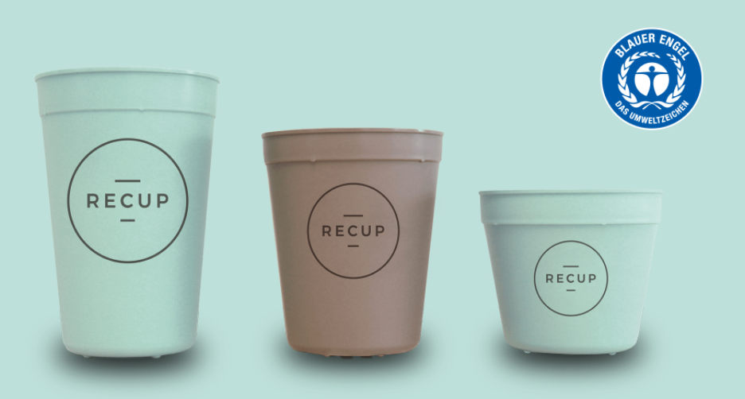
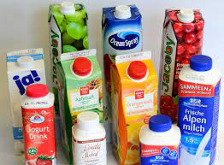
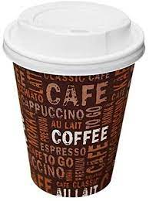
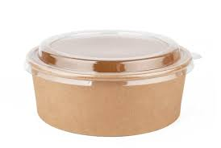
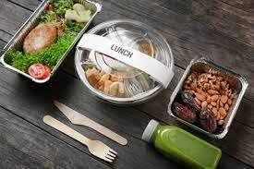
Packaging systems
There exist many different packaging systems
Packaging is important for the protection of food, transportability, storability and customer benefit
The recyclability and CO₂-footprint of the different packaging-systems varies greatly
Typically, a differentiation is made between disposable and reusable packaging
The aim is to reduce disposable packaging as much as possible
The ecological benefit of reusable packaging depends strongly on the maximum usage cycles and the effort required for cleaning
How can the number of usage cycles be increased and the cleaning effort reduced?
Reusable packaging’s and deposit systems differs from country to country, cross-boarder systems are not available
There is a need to rethink packaging systems

Slide 3
IQPAK
Suitable for hot and cold beverages, milk products, juices, food
Suitable for reverse vending machine and low-threshold take-back-systems
Deposit return is possible everywhere (suitable for cross-border use)
Integration of an NFC chip
Flexible deposit amount
Suitable for cross-border use
Smart functions
Maximizing of circulation cycles of the IQPAK-System
Reuse without energy-intensive washing processes
3-Layer Structure
Handling layer; system layer; content layer
Handling layer should be individually designable (for each reuse)
Automatable refurbish-process (without washing process)
Use of commercially available and recyclable materials
Different packaging-systems should be replaced according to the same principle

Slide 4
IQPAK Structure (Illustrated by the example of a cup)
System-Layer
A system layer should be completely protected by a very thin film (content layer, handling layer)
Different materials are conceivable for the different layers (polymers, biopolymers, fibre materials, …)
The refurbishing is carried out by exchanging the thin content and handling layers
The main component (system layer) can be theoretically reuse unlimited
No ageing of the system layer due to washing processes and mechanical stress
The refurbish process takes place without the use of any chemicals and/or cleaning agents and without energy intensive washing processes
Current project funding by Deutsche Bundesstiftung Umwelt (DBU)
Handling-Layer
Content-Layer

Slide 5
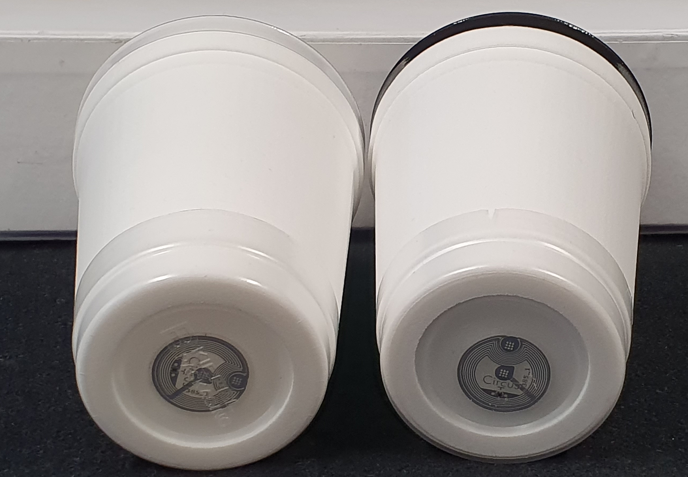
IQPAK
Integration of NFC chip
Integration of the NFC chip in the system layer of the packaging system
Each package gets an individual ID-Number
Via ID, the packaging can be identified in a database
Different information can be stored into the database
Status of refurbishing
Example: not fillable if flag is negative
Exact allocation of the used materials
Important for recycling of the recyclables
The deposit value
Example: Different deposits are possible
Cross-boarder deposit handling is possible
Number of recirculations / CO₂-savings
History of usage
App-Use

Slide 6
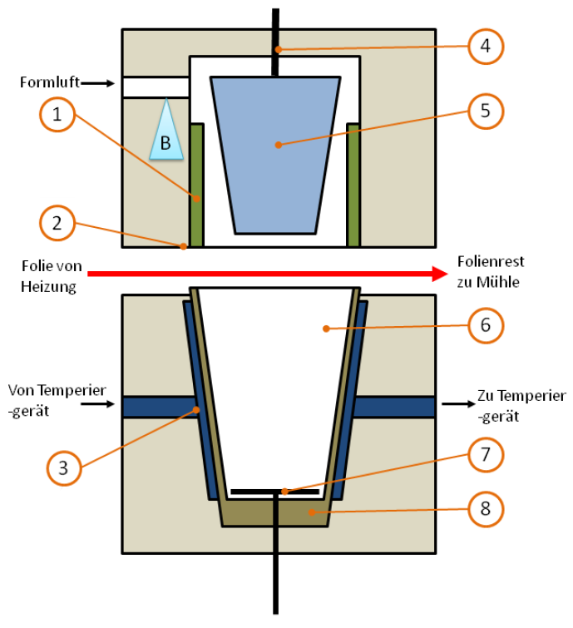
IQPAK: Refurbishing-Process
Refurbishing using thermoforming processes
Thermoforming of the content-layer directly into the system-layer
Apply of the handling-layer using shrink-sleeve technique
In the first step of reprocessing, the handling layer is removed automatically and collected separately in a separate material stream
Once the handling layer has been removed, the system layer is held with a clean gripper arm
After the handling layer has been removed, a handling system makes it possible to remove the content layer and the bottom of the cup
The system layer is then provided with a new content layer and handling layer
The status "refurbished" is write to the NFC chip.
1 Clamping Unit
2 Cutting plate
3 Cooling system
4 Bar of pre-stretch unit
5 Pre-stretcher
6 Mould insert
7 Ejector
8 Cutting Unit

Slide 7
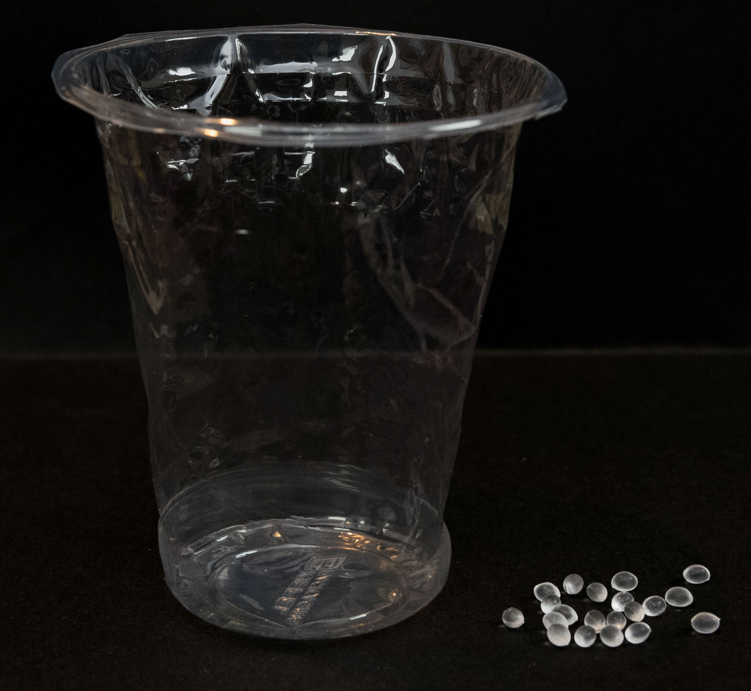
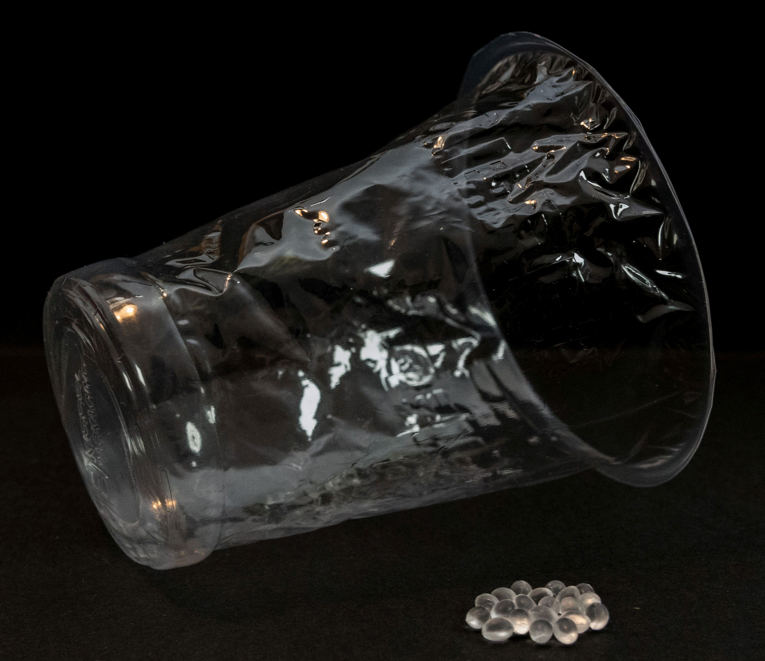
IQPAK: Possible Material Quantity Content-Layer
Content-Layer: 0,5g

Slide 8
IQPAK Ecological consideration
Endres, H.-J.; Assessment of environmental sustainability of composites, Institut für Kunststoff- und Kreislauftechnik – Universität Hannover, JEC Forum DACH, 2021, Frankfurt
Considering the proposed new packaging system, the following assumptions arise:
Taking into account current and non-optimised processing procedures, it can be conservatively assumed that approx. 2,3g of polypropylene is needed during refurbishing process. These materials are collected and fed into the corresponding material flow for recycling.
According to the Institute for Plastics Technology and Recycling (University of Hannover), the CO2 equivalent of 1kg of virgin polypropylene is approx. 2kg CO2e, for recycled material approx. 1,2kg CO2e. For processing, further 0.45kg CO2e / 1kg can be added.
Taking into account the necessary amount of material for cup processing, this results in a CO2 equivalent of 4,5g CO2e per 1000 cups for virgin PP and 2,3kg CO2e per 1000 cups for recycled material.
Process | CO₂-equivalent kg CO₂e / 1000 Cups | Percen-tage | Savings
(Industrial) Washing Process for current subsitutes (e.g. ReCup) | 8,7 | 100% | 0%
Refurbishing with virgin PP Usage of 2,3g PP/Cup | 5,6 | 64% | 36%
Refurbishing with PP-Recyclates Usage of 2,3g PP/Cup | 3,8 | 44% | 56%
The benefit from an increase of using cycles of the cup core is actually not taken into account
Potential
An independent evaluation of the eco-potential has been commissioned and is carried out by the ifeu-institute

Slide 9
Ifeu report
To ensure that the assumptions, regarding the ecological advantages of iqpak, are correct, we had them checked by the ifeu Institute.
This brief report was carried out by ifeu - Institut für Energie und Umweltforschung Heidelberg gGmbH on behalf of the company Löning und Partner. The primary objective of the report is an environmental assessment of the iqpak™ system, taking particular account of the estimated greenhouse gas analysis carried out by the Fraunhofer LBF.
This is a 6-page report in german language

Slide 10
Estimated eco potential (CO2-foot print) of IQpak according to Ifeu-Institute Example: Cup
Process | CO₂-equivalent kg CO₂e / 1000 Cups | Percen-tage | Savings
(Industrial) Washing Process for current subsitutes (e.g. ReCup) | 8,7 | 100% | 0%
Refurbishing with virgin PP Usage of 2,3g PP/Cup | 5,6 | 64% | 36%
Refurbishing with PP-Recyclates Usage of 2,3g PP/Cup | 3,8 | 44% | 56%
PP Cradle to gate: 5.34 kg CO2e per 1,000 cups >> 39 % savings (previous estimation: 5.6 kg CO2e >> 36 % savings)
PP Cradle to grave: 4.80 kg CO2e per 1,000 cups with a recycling rate of 90% >> 45 % savings
rPP Cradle to gate: 3.67 kg CO2e per 1,000 cups >> 58 % savings (previous estimation: 3.8 kg CO2e >> 56 % savings)
rPP Cradle to grave: 3.14 kg CO2e per 1,000 cups with a recycling rate of 90% >> 64 % savings

Slide 11
Ifeu report
Distinguishing features of IQpak:
Washing process is replaced by refurbishing process with weight reduction in recycable components >> reduces CO₂-foot print >> recyclable components can be sorted directly into the appropriate recycling fraction
The IQpak™-system is to be welcomed as an innovation in the packaging market >> significant reduction in disposable packaging which serves the ultimate goal of the waste hierarchy - waste prevention
Complete digital integration of IQpak™-system during usage and refurbishing process >> enables the cross-border use in EU >> improves production planning and control of the pool (reprocessors and fillers know where the packaging is located and what return is to be expected (control of an appropriate pool size)) >> high-quality recycling of the recyclable components by storing the respective system specifications (the system knows which materials have been used so that the recyclable components can be sorted directly into the appropriate recycling fraction)

Slide 12
Ifeu report
Further comments:
The definitions and assumptions made in the context of the orienting calculations are comprehensible, the balanced results are valid and can be regarded as directionally reliable for the evaluation of the IQpak™ system.
Basically, we consider the IQpak™ system to be predestined for the packaging of dairy products such as yogurt, quark, desserts, etc. due to its design. >> In this area, IQpak™, as a system that is more or less freely scalable in terms of fill size, can offer a reusable alternative that avoids the hygienic problems of deposit return known from practical experience. >> A comparison with current alternatives (e.g. glass + metal lid) will show a life cycle assessment advantage.

Slide 13
Estimated eco potential (CO2-foot print) of IQpak Example: composite cardboard
Process | CO₂-equivalent kg CO₂e / 1000 l | CO₂-equivalent kg CO₂e / 50.000 l (50 cycles)
composite cardboard | 31-62 | 1550-3100
IQPAK System-Layer / PP-Recyclates | 86 | 86
IQPAK refurbishing with virgin PP | 8,9 | 445
IQPAK total | 94,9 | 531
With 50 rotations of IQPAK CO2-savings are app. between 66% - 83%

Slide 14
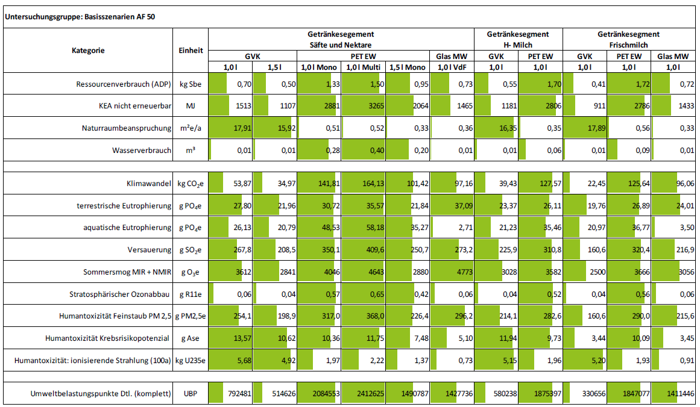
Estimated eco potential (CO2-foot print) of IQpak Source: Ökobilanzielle Betrachtung von Getränkeverbundkartons in Deutschland - IFEU

Slide 15
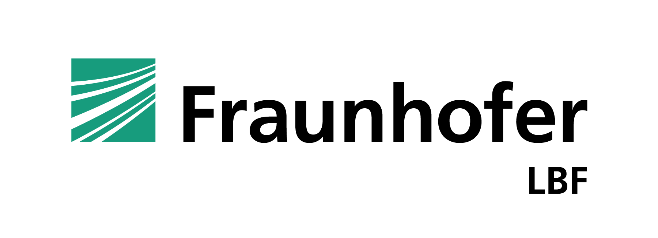
Contact
—
Dr. Christian Beinert
Head of Department Polymer Processing and Component Design
Division Plastics
phone. +49 6151 705-8735
christian.beinert@lbf.fraunhofer.de
30.06.2022

Slide 16
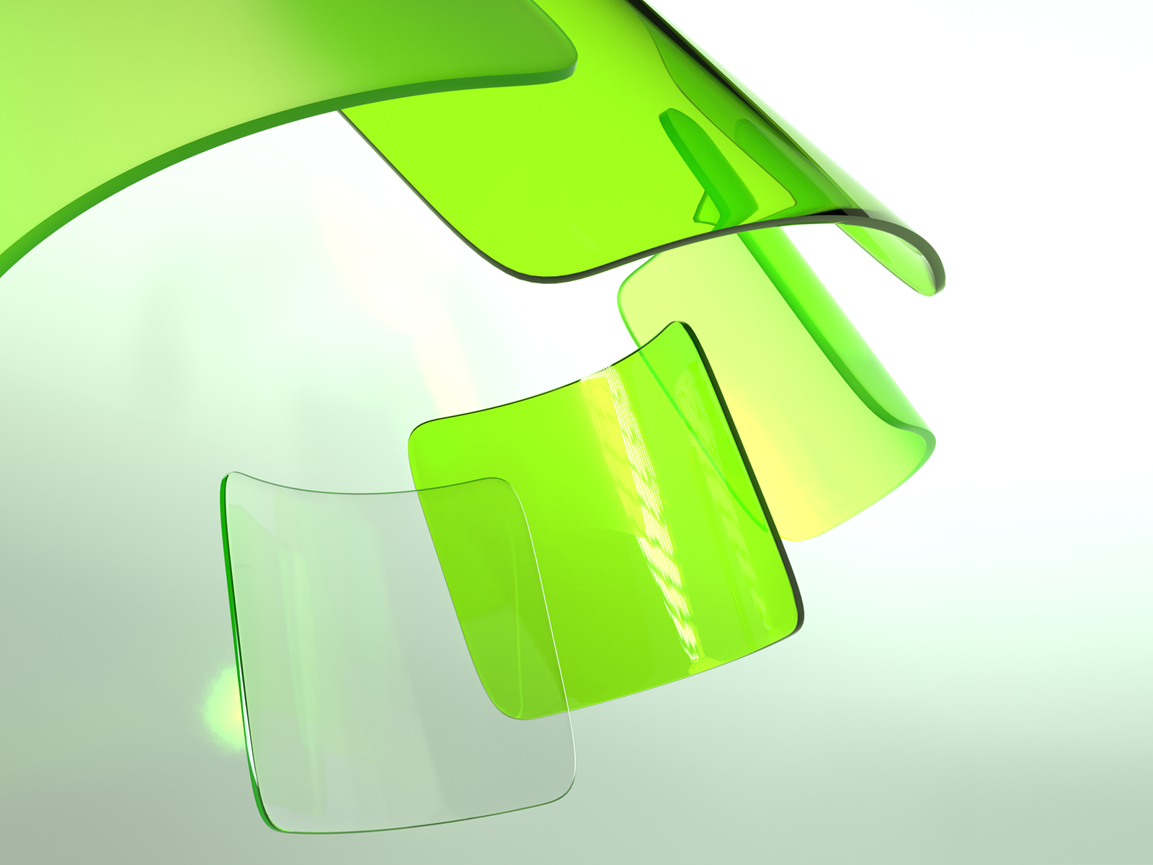
IQpak - Pak it green³
IQpak - die wahrscheinlich nachhaltigste Mehrwegverpackung auf dem Markt.

Slide 17
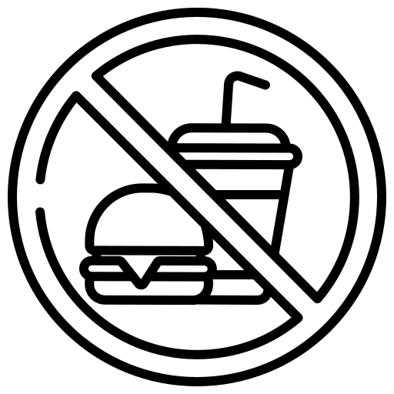
IQpak - A true circular economy with Exchange Layers
IQpak-Database trace the composition of each single IQpak and guarantees monomaterial streams
Content-Layer
Non Food- Content
System-Layer
Made of recyclate
Touch-Layer
17

Slide 18
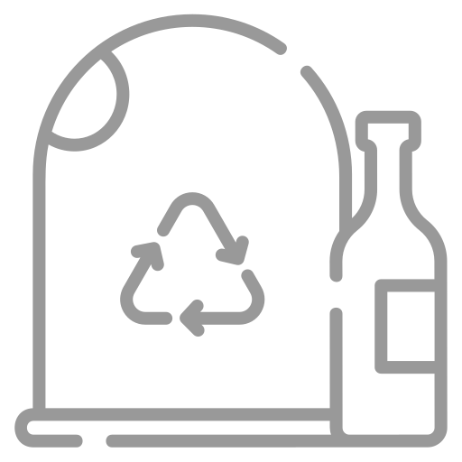
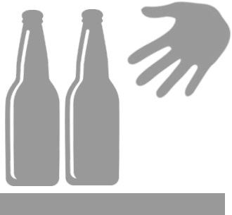
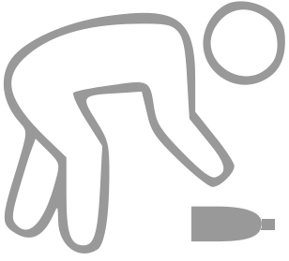
IQpak - Reverse logistics
IQpak-Database prevents fraud, enables cross-border deposits and activates low-threshold redemption agents
Integration in RVM's
Reverse Logistic Hubs with Professionals
(Retailers, Beverage Wholesaler, Recycling Providers)
New Easy Drop Off RVM's
Redemption by Collectors with the IQcycle App
Social Agents
Micro Retailers
(Kiosk, Gas Stations)
18

Slide 19
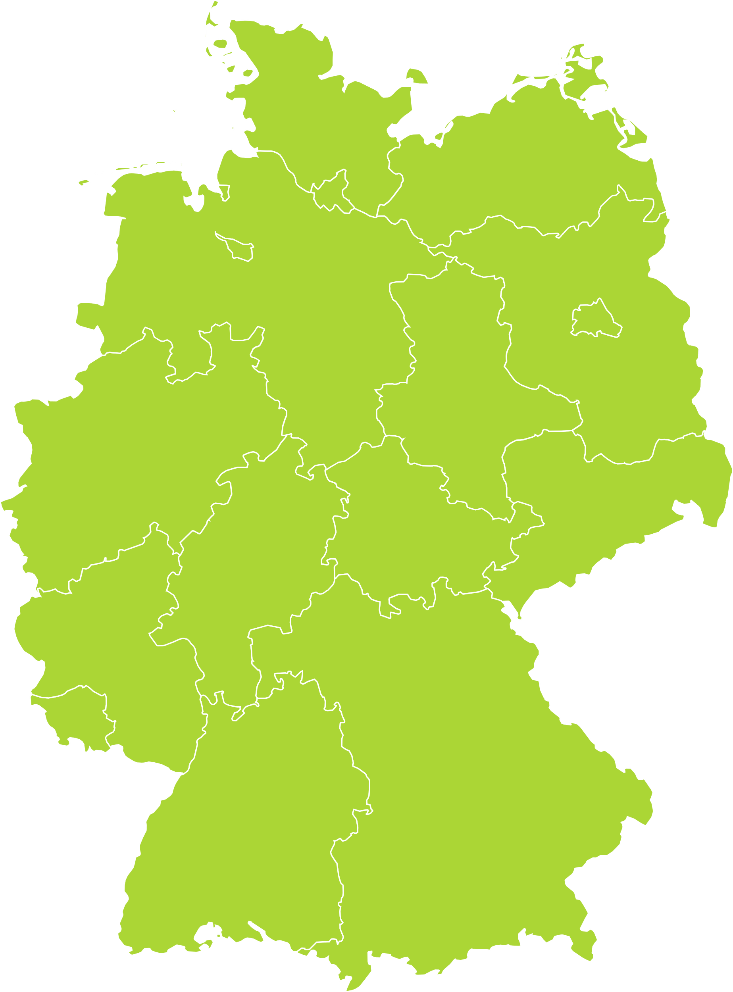
Map of a Modell for Reverse and Refurbish Hubs
distance max. 150 km
final logistic model will be supported by Fraunhofer IML Dortmund
19

Slide 20
Map of a Modell for Reverse and Refurbish Hubs
2x
3x
2x
existent Wholesaler Network
the IQpak-Database prevents fraud, enables cross-border deposits and activates low-threshold reversals
3x
6x
4x
3x
8x
3x
5x
3x
4x
4x
4x
2x
5x
3x
2x
2x
3x
2x
6x
8x
4x
3x
4x
2x
4x
6x
3x
5x
2x
4x
8x
2x
4x
5x
3x
3x
3x
2x
4x
20

Slide 21
Vielen Dank, Thanks for Attention
+49 441 777 9696
info@iqpak.com
21

Slide 22
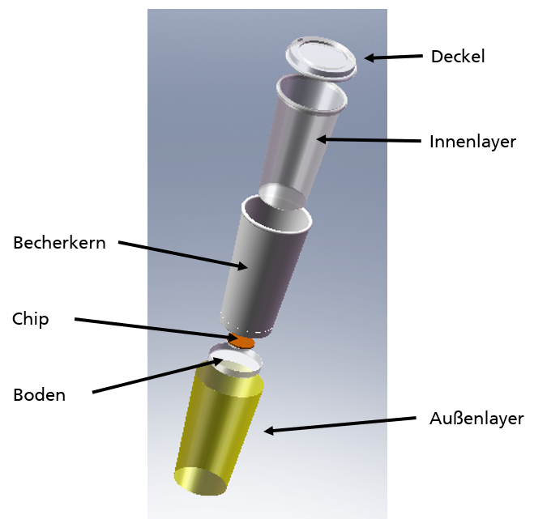
IQPAK Structure (Illustrated by the example of a cup)
Lid
A system layer should be completely protected by a very thin film (content layer, handling layer)
Different materials are conceivable for the different layers (polymers, biopolymers, fibre materials, …)
The refurbishing is carried out by exchanging the thin content and handling layers
The main component (system layer) can be theoretically reuse unlimited
No ageing of the system layer due to washing processes and mechanical stress
The refurbish process takes place without the use of any chemicals and/or cleaning agents and without energy intensive washing processes
Current project funding by Deutsche Bundesstiftung Umwelt (DBU)
Content-Layer
System-Layer
NFC-Chip
Handling-Layer (bottom-part)
Handling-Layer

